Slide 1
Weekly Update #2
Team Name: EM Drop the Microelectronics
Project Manager: Barak Barclay
Logistics & Finance Manager: Alicia Lawrence
Design Manager: Brian Griffen
Test Manager: Chris Sherwood
Sponsor: EM Microelectronic
Faculty Sponsor: Dr. Byeong Lee
22 March 2019

Slide 2
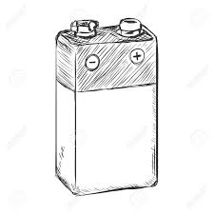
Problem: 9V Battery Low Voltage Detection
Some products need to have their batteries replaced before the battery dies completely
Our team must design a board that checks that voltage and broadcasts once the voltage is critical
Broadcasts only when low
Sends BT packet

Slide 3

Bluetooth Specifications
Bluetooth Version 5.0
EM9304
Bluetooth Packet Type
Non-connectable vs. Connectable
Power Consumption vs. Need for Pairing
EM9304
Certified w/ FCC for wireless transmission
Supports 1.5V & 3V batteries
Low-power switching regulator

Slide 4
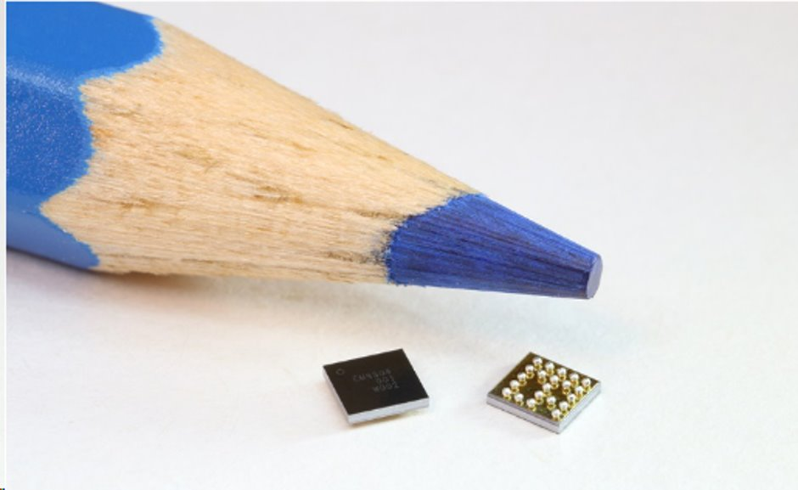
Battery Specifications
Battery Power Consumption
Reduction of less than 20%
Battery Alternatives
Alkaline vs. Lithium Ion
Cost vs. Capacity
Total part cost <$5 at 10,000 units
Temperature Range?
Size
Inner vs. Outer Module
Battery Dimensions (ANSI/ EC Standard)
Max: 48.5mm x 26.5mm x 17.5mm
Min: 48mm x 25mm x 15mm

Slide 5

System Block Diagram
Battery powers entire system
Need voltage stepped down for EM9304
Some type of circuitry detects voltage or current from sense line to EM9304

Slide 6
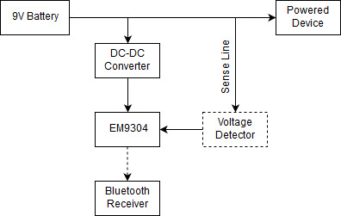
System Block Diagram

Slide 7
Resistive Load
To properly characterize battery we need an idea of load
Loads vary between photoelectric, ionization, and combination detectors
Manufacturer | Model | Product | Type of value | Average Current [uA] | Load Resistance [kOhms]
ANSI | - | Battery | Spec | 209.3 | 43
Ultra Life | U9VL-X | Battery | Calculated | 13.7 | 657
First Alert | SA303 | Smoke Alarm | Measured | 7.3 | 1,233

Slide 8
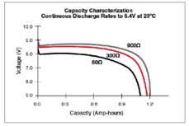
Battery Characterization Tests
Capacity – ability to store energy
Internal Resistance – ability to deliver current
Self-Discharge – describes mechanical integrity of battery over time

Slide 9
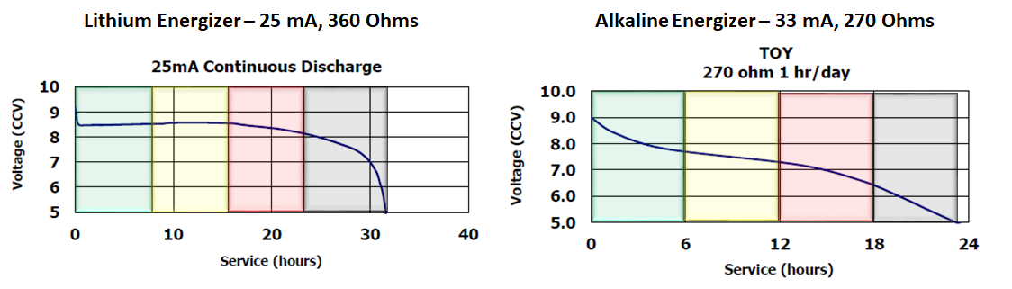
Lithium and Alkaline Battery Comparison
Circuit Response | Battery Capacity | Lithium Voltage (V) |  |  | Alkaline Voltage (V)
 |  | Max | Min | Delta | Max | Min | Delta
Sample Voltage | 100% to 75% | 9 | 8.5 | 0.5 | 9 | 7.8 | 1.2
Advertise Alert | 75% to 50% | 8.5 | 8.5 | 0 | 7.8 | 7.2 | 0.6
Smoke Alarm Beeping | 50% to 25% | 8.5 | 8.1 | 0.4 | 7.2 | 6.5 | 0.7
Battery Dead | 25% to 0% | 8.1 | 5 | 3.1 | 6.5 | 5 | 1.5

Slide 10
Spec Sheet
 | MIN | TYP | MAX
Power Supply (V) | 6 |  | 9.5
Temperature (C) |  | 25 | 60
Alert Voltage (V)
Current Consumption (uA) | 2.74 |  | 41.86
Sampling Interval (per Hour) |  | 1
Advertising Interval (Hz) |  | 0.5
Sampling Length (# of days?)

Slide 11

Plans for Next Week
Test various batteries for IV curves
Decide on a battery
Decide on a percentage for the BLE advertisements to start
Study published battery tests and models

